Slide 1
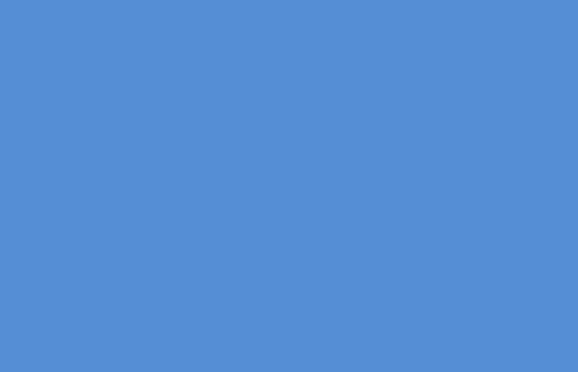
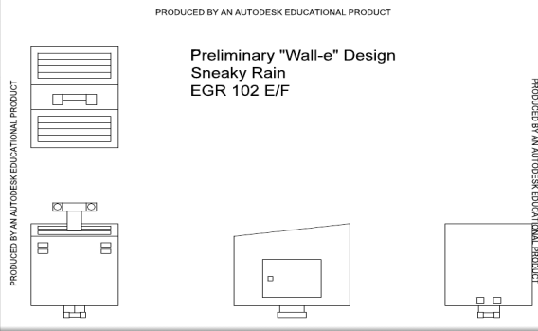

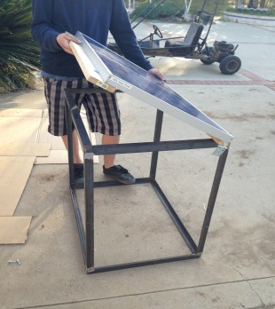
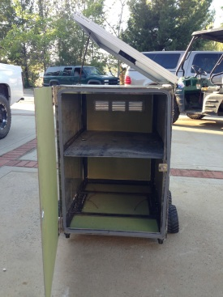
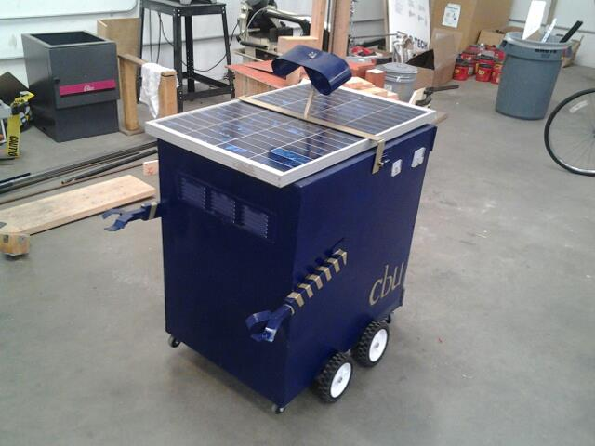
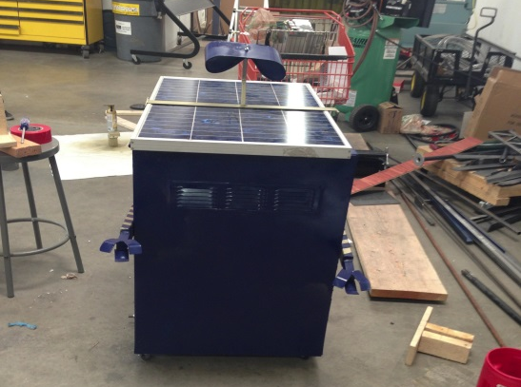
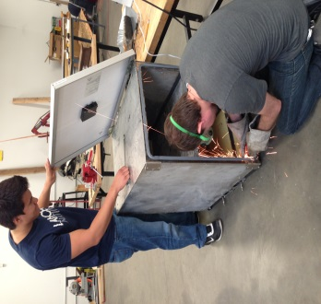

CBU’s Wall-E Powered by the Sun
By: Sneaky Rain
Our initial design on the AutoCAD drawing software
Wall-E is designed to power common electronic devices.
The frame measured to hold our solar panel by Daniel Lombardo
The initial base structure without electrical components
Side view of our remote controlled
“Wall-E” solar station
Front view of the “Wall-E” solar station
Jordan Rainy filing down screws while Joshua Hanson checks out the solar panel
Client: Dr. Chun
Team members: Jordan Rainey, Jordan Ziegler, Daniel Lombardo, Rocky DeLyon, Joshua Hanson

